Slide 3
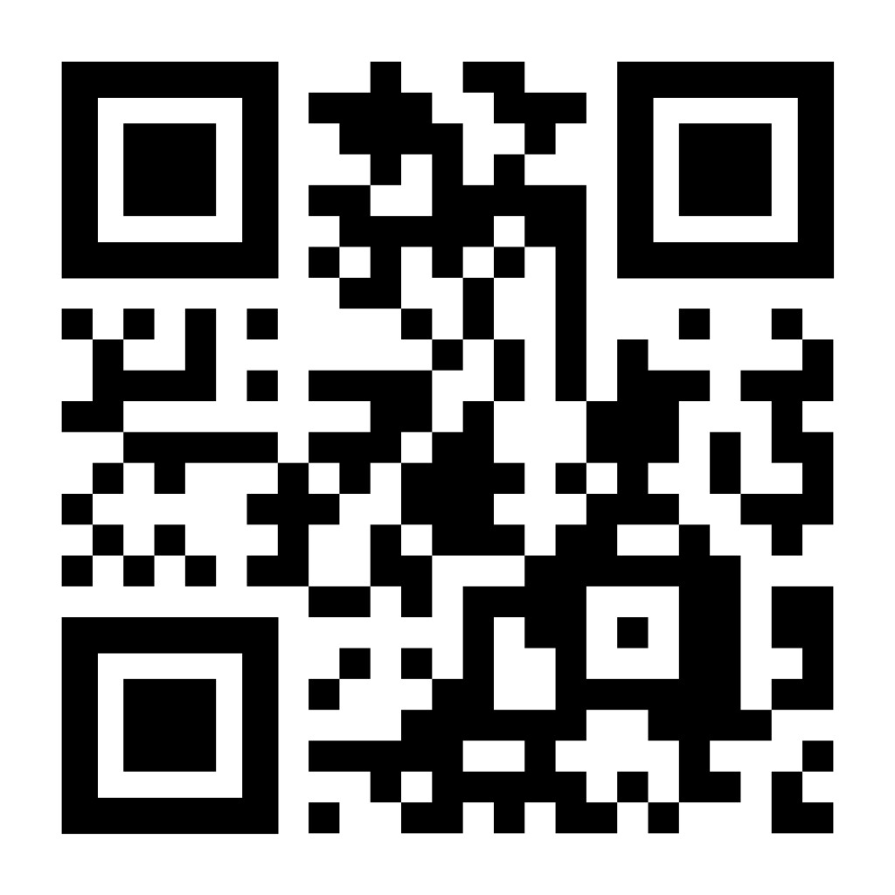

Session Feedback
Please scan this QR code using your mobile or tablet to access short
feedback surveys for
all APC sessions.

