Slide 1
Session Title
Presented by:

Slide 2
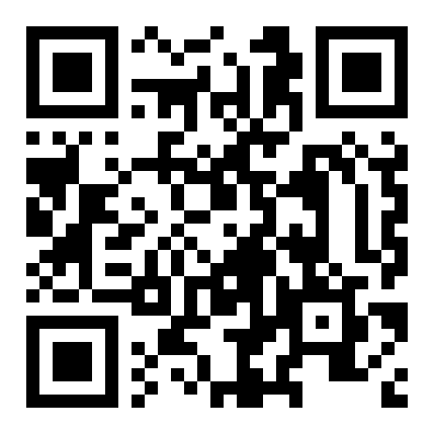
Do you need NASBA CPE credits?
Navigate to website: iofm.cnf.io
or scan the QR code →
Check-in and check-out of your sessions to track your attendance for NASBA CPEs
Certified with IOFM? No need to check-in and out of sessions. Self-report CEUs on IOFM.com instead after the event!

Slide 3
Title
Content

Slide 4
Actionable Takeaways
Please keep this slide at the end of your presentation & provide at least three actionable takeaways attendees can implement from what they learned in your session.
Xyz
Xyz

Slide 5

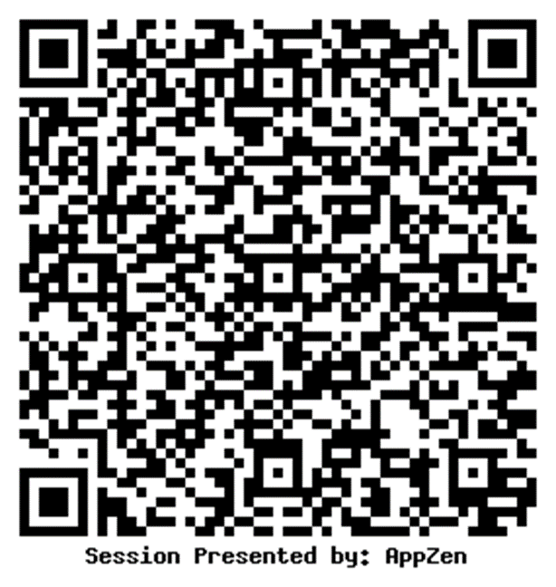
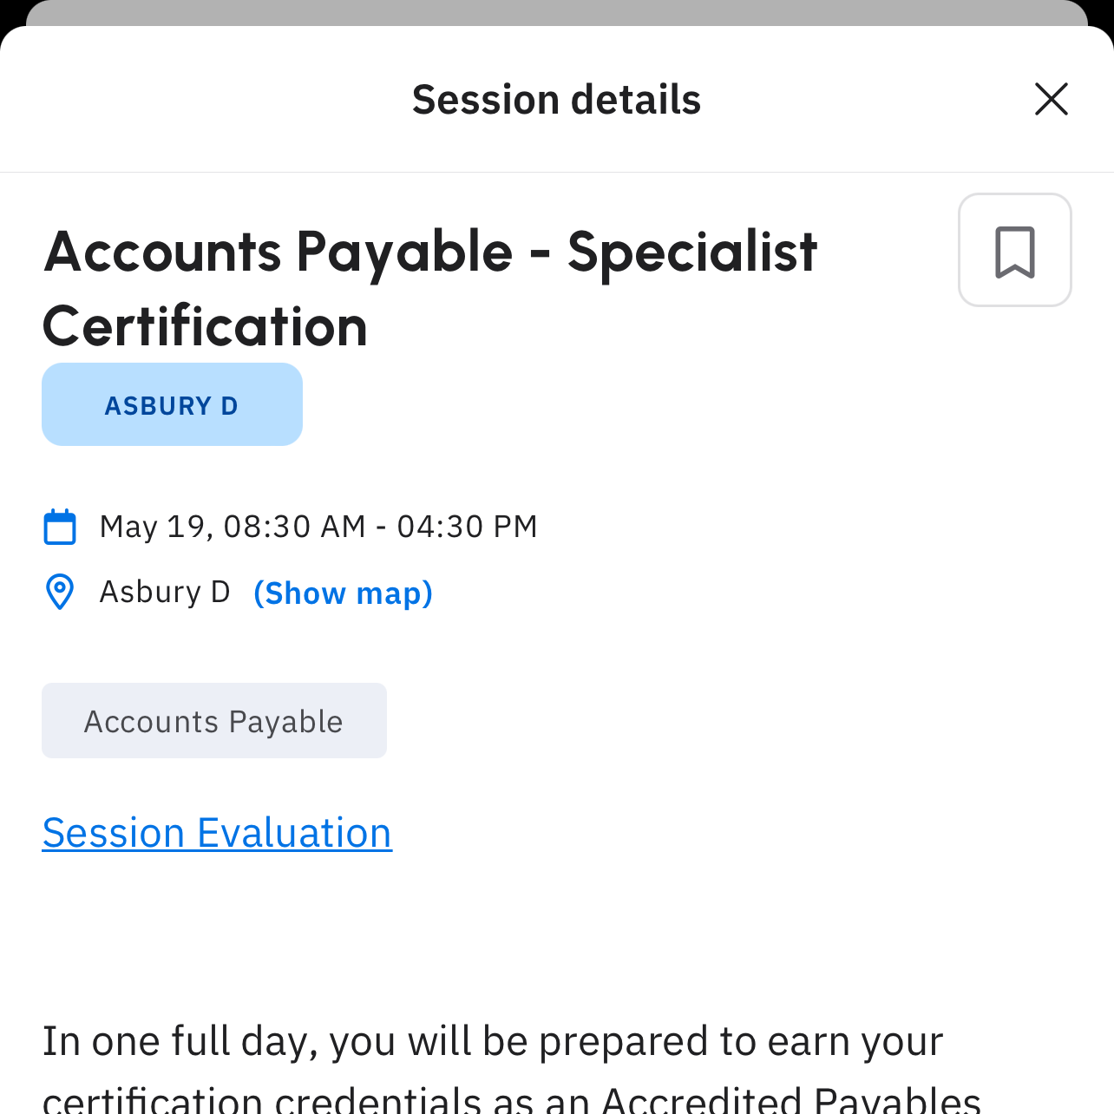
Please scan this QR code using your mobile to access a short feedback survey à
Also accessible via the mobile app
QR Codes will be shared closer to event

Slide 6
QUESTIONS?
{Last Slide - Speaker contact details ]
REMINDER!
If you checked in for NASBA CPE credit, check out at iofm.cnf.io

