Slide 2
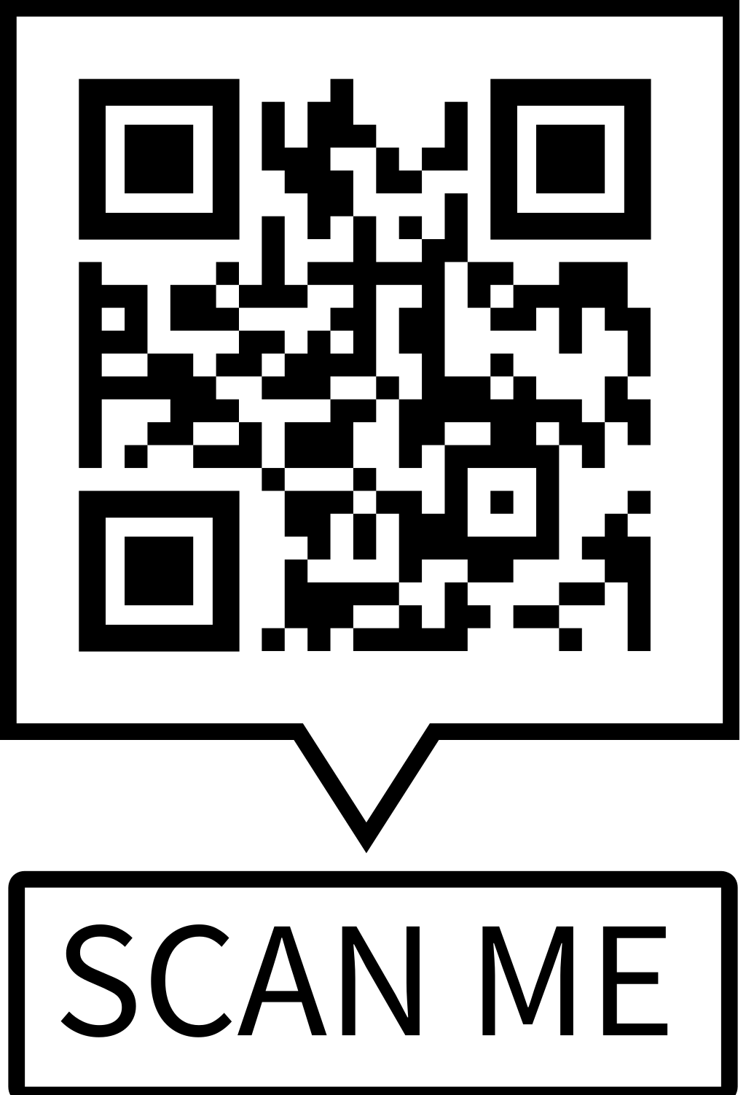
Session Evaluations
Please submit your feedback

